Slide 1
A Style-Based Generator Architecture for Generative Adversarial Networks
Jianghao Lin
Aug 13, 2019

Slide 2
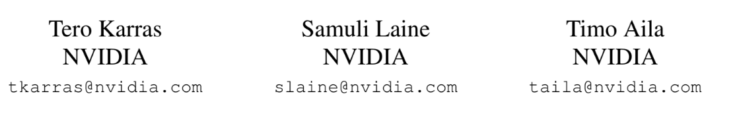
CVPR 2019
A Style-Based Generator Architecture for Generative Adversarial Networks

Slide 3
Content
Introduction
Motivation
Architecture Details

Slide 4
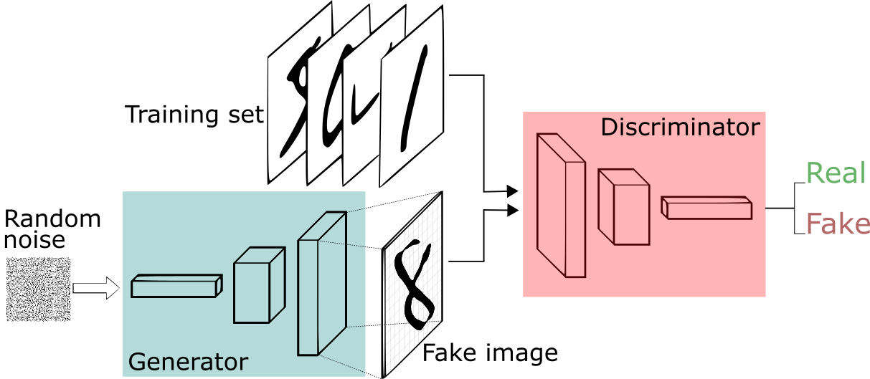
What is GAN (Generative Adversarial Networks) ?
Usually a latent vector: [1.65, 0.68, 1.98, 0.25, 0.39, …, 0.87, 2.91, 1.87]

Slide 5
Content
Introduction
Motivation
Architecture Details

Slide 6
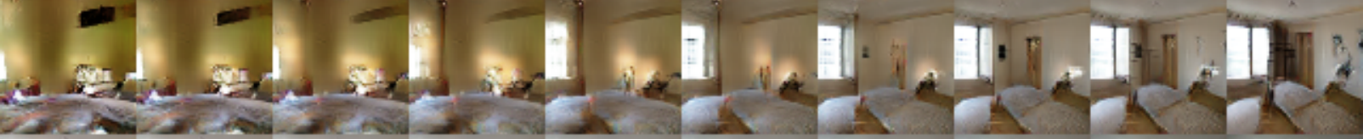
Latent Vector z: not just a random noise
Interpolation between latent vectors
Realistic generated images + Feature controlling ?

Slide 7
Problem to be solved: Feature Entanglement
Latent vector: [1.65, 0.68, 1.98, 0.25, 0.39, …, 0.87, 2.91, 1.87]
0.78
Change of hair color
Change of gender

Slide 8
Problem to be solved: Feature Entanglement
Latent vector: [1.65, 0.68, 1.98, 0.25, 0.39, …, 0.87, 2.91, 1.87]
0.77
0.78
Change of hair color
Change of gender

Slide 9
StyleGAN
high-quality and realistic images (based on ProGAN)
Feature Disentanglement: superior control and understanding of the features of generated images

Slide 10
Content
Introduction
Motivation
Architecture Details
Evaluation

Slide 11
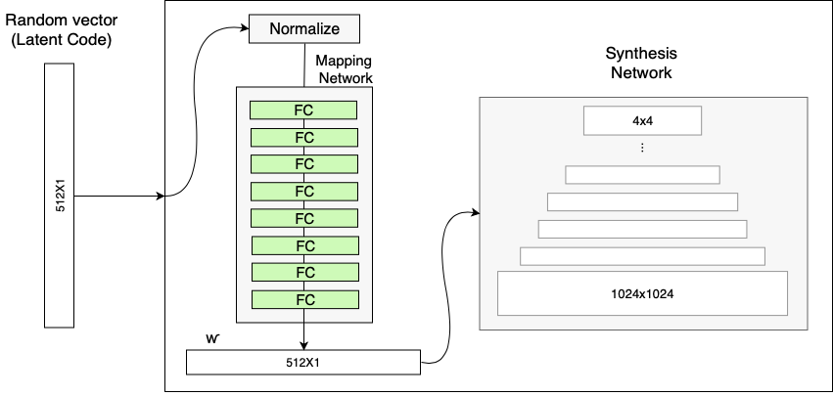
Mapping Network

Slide 12
Style Modules (AdaIN)
When we want to paint a face with features:
[black hair, yellow skin, wearing glasses, smiling, woman, …, white teeth]

Slide 13
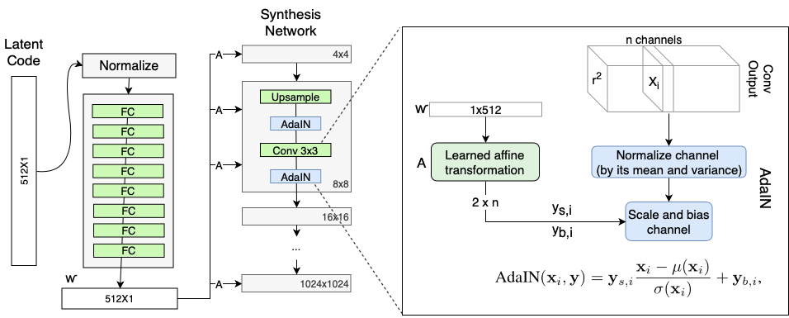
Style Modules (AdaIN)

Slide 14
Constant Input of Generator
What about the 4 x 4 layer block ?

Slide 15
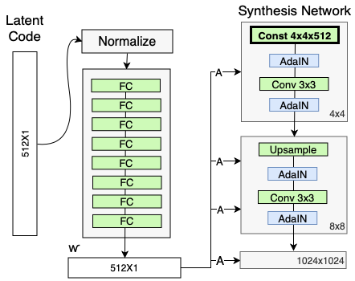
Constant Input of Generator

Slide 16
Stochastic variation
Variation term
512 x 1

Slide 17
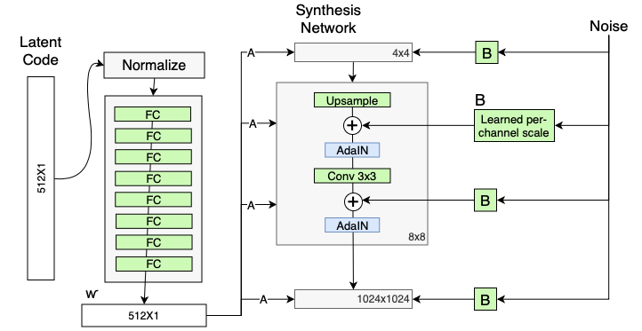
Stochastic variation

Slide 18
Style Mixing
Independently insert, independently handled.

Slide 19

Style Mixing
Latent code 1: [blue hair, smiling, no glasses]
Latent code 2: [black hair, grinning, round glasses]
Latent code 3: [pink hair, no-smile, sun glasses]

Slide 20
Content
Introduction
Motivation
Architecture Details
Evaluation

